Slide 1


Session 36
How not to be a worry pot

Slide 2
We’ve been talking about how to deal with problems and our worries.
Sometimes, we make things a bit worse for ourselves if we let our thoughts or behaviours run wild.
We also tell ourselves that we’re no good and jump up and down squashing our self-esteem. For example, ‘I failed that exam so that means I’m an idiot, useless, hopeless and I think I should run away’. No, everyone fails at something so think about what happened and try and make it right.
We can make them seem bigger as if we are putting them under a magnifying glass so that we think they are dreadful, huge and it will become a catastrophe. It won’t.
We can also only think of the negative side of things, such as ‘I didn’t get chosen for the football team so that means I’m useless and I’ll never be able to play football’. You can play with your friends or keep working at it and you might get chosen the next time round.
A funny thing that we sometimes believe is that other people can read our minds. ‘My friend knows I’m upset and she’s being mean not helping me’. Well, maybe she has no idea that you’re upset so you may have to tell her.

Slide 3

Do you have a crystal ball that you can look into and tell the future?
Possibly not. ‘I haven’t got a best friend so that means I’ll never have one when I’m older’. No, there is no reason for that to happen. Try not to imagine what will happen in the future if something has happened now.
It’s always good to have hopes and dreams as long as we don’t go too fast so that we want to stop if we don’t get past every stage.
What we need to do is not set ourselves up to fail at something. If you’ve never climbed a mountain before and you decide to climb the highest one around it’s likely you won’t be able to. Set your expectations on things that you can achieve and then work your way up to bigger things.

Slide 4




One step
at a time
and you’ll get there.
Do you remember we once spoke about something helpful you can use to train yourself to think first?
If you keep worrying about things or are impulsive and shout or hit out, this can help you to calm your worries and stop you from rushing head first into things.

Slide 5


Tell yourself:
STOP!
THINK
ACT
This STOP, THINK, ACT is really really, really good to use if you’re worried, very angry, impulsive, rushing, a little out of control, overexcited and many other things.

Slide 6



Take a breath then…
STOP
what you’re doing or thinking.
Take another breath then…
THINK
about what you should be doing.
Take a third breath then…
ACT
go and do what you know you should be doing.
It works so do it as often as you can and you’ll be amazed at the power it gives you.

Slide 7
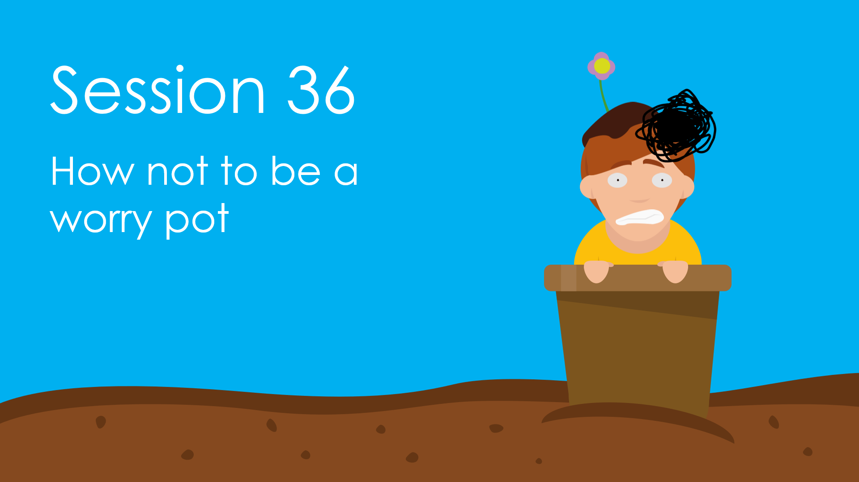
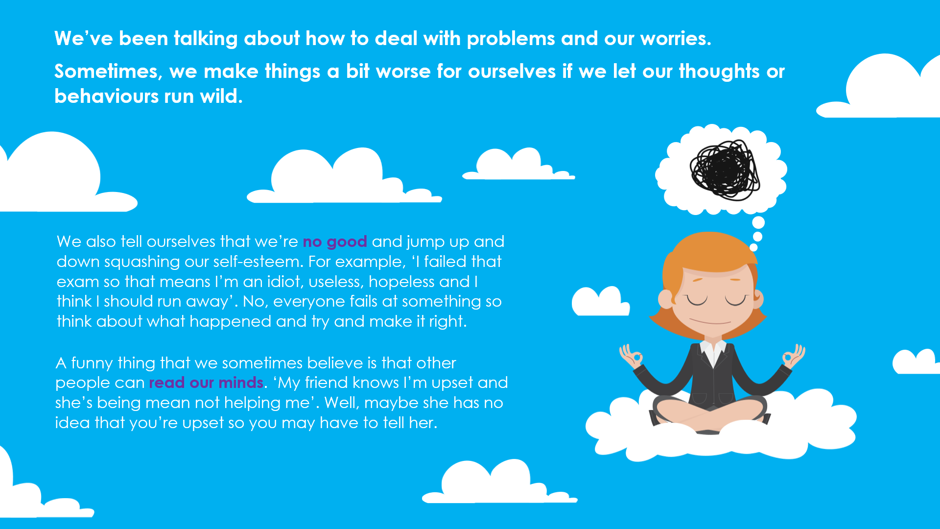
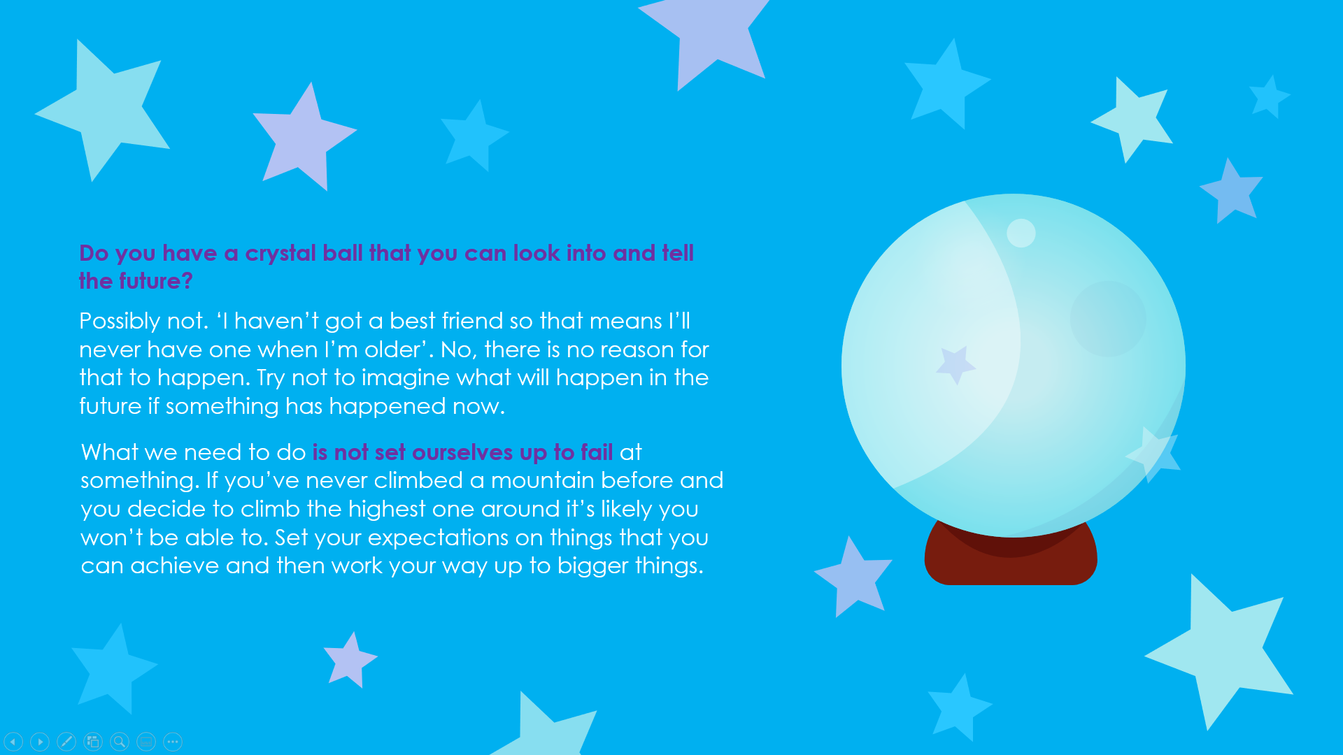
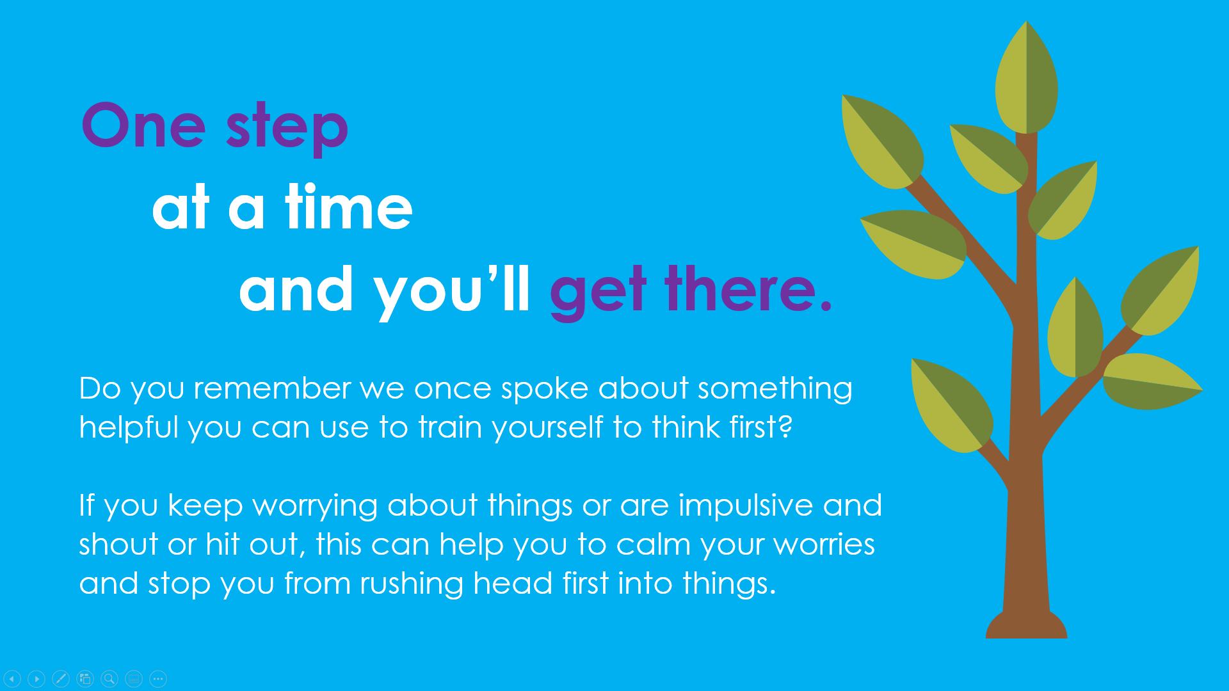
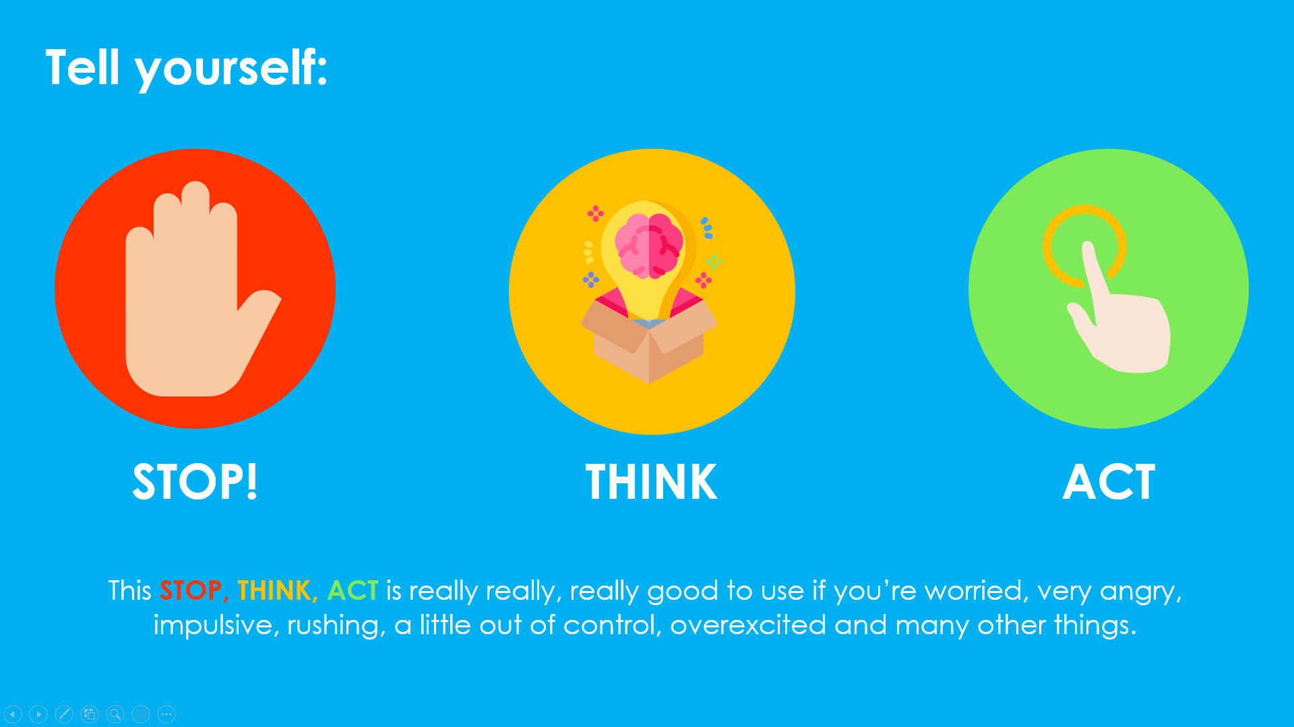
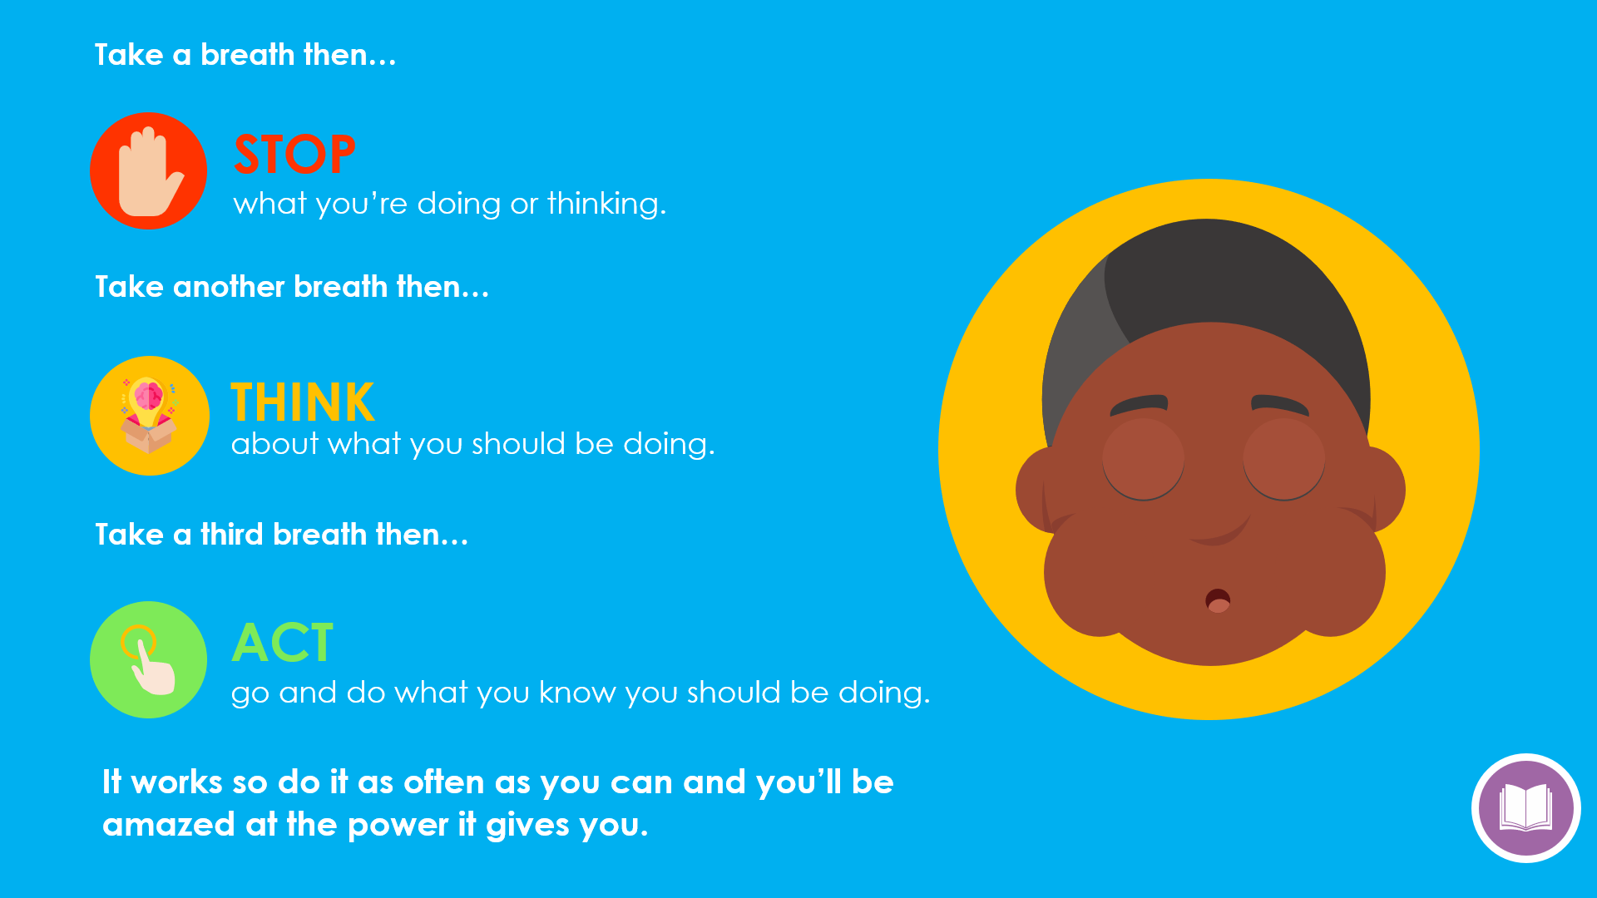
Session 36
Slides: 186 - 191
Get the children to give examples and use these in the class to show them how they can stop, think and act. Real examples will help them learn what is meant by it and roleplay scenarios which helps the concept to become integrated.
Get the children to make their own Worry Box and a traffic light of STOP THINK ACT or a chart of their liking that they can keep at home.
Equipment:
Cardboard, paper or an old box.
Craft material with colours for the traffic lights

