Slide 1
Session 1
Monkey Mind
and the Mountain

Slide 2




Rockets
When thoughts
in your head
in your mouth
Whizz around
Inside you
Springs
in your body
Feelings
in your heart

Slide 3


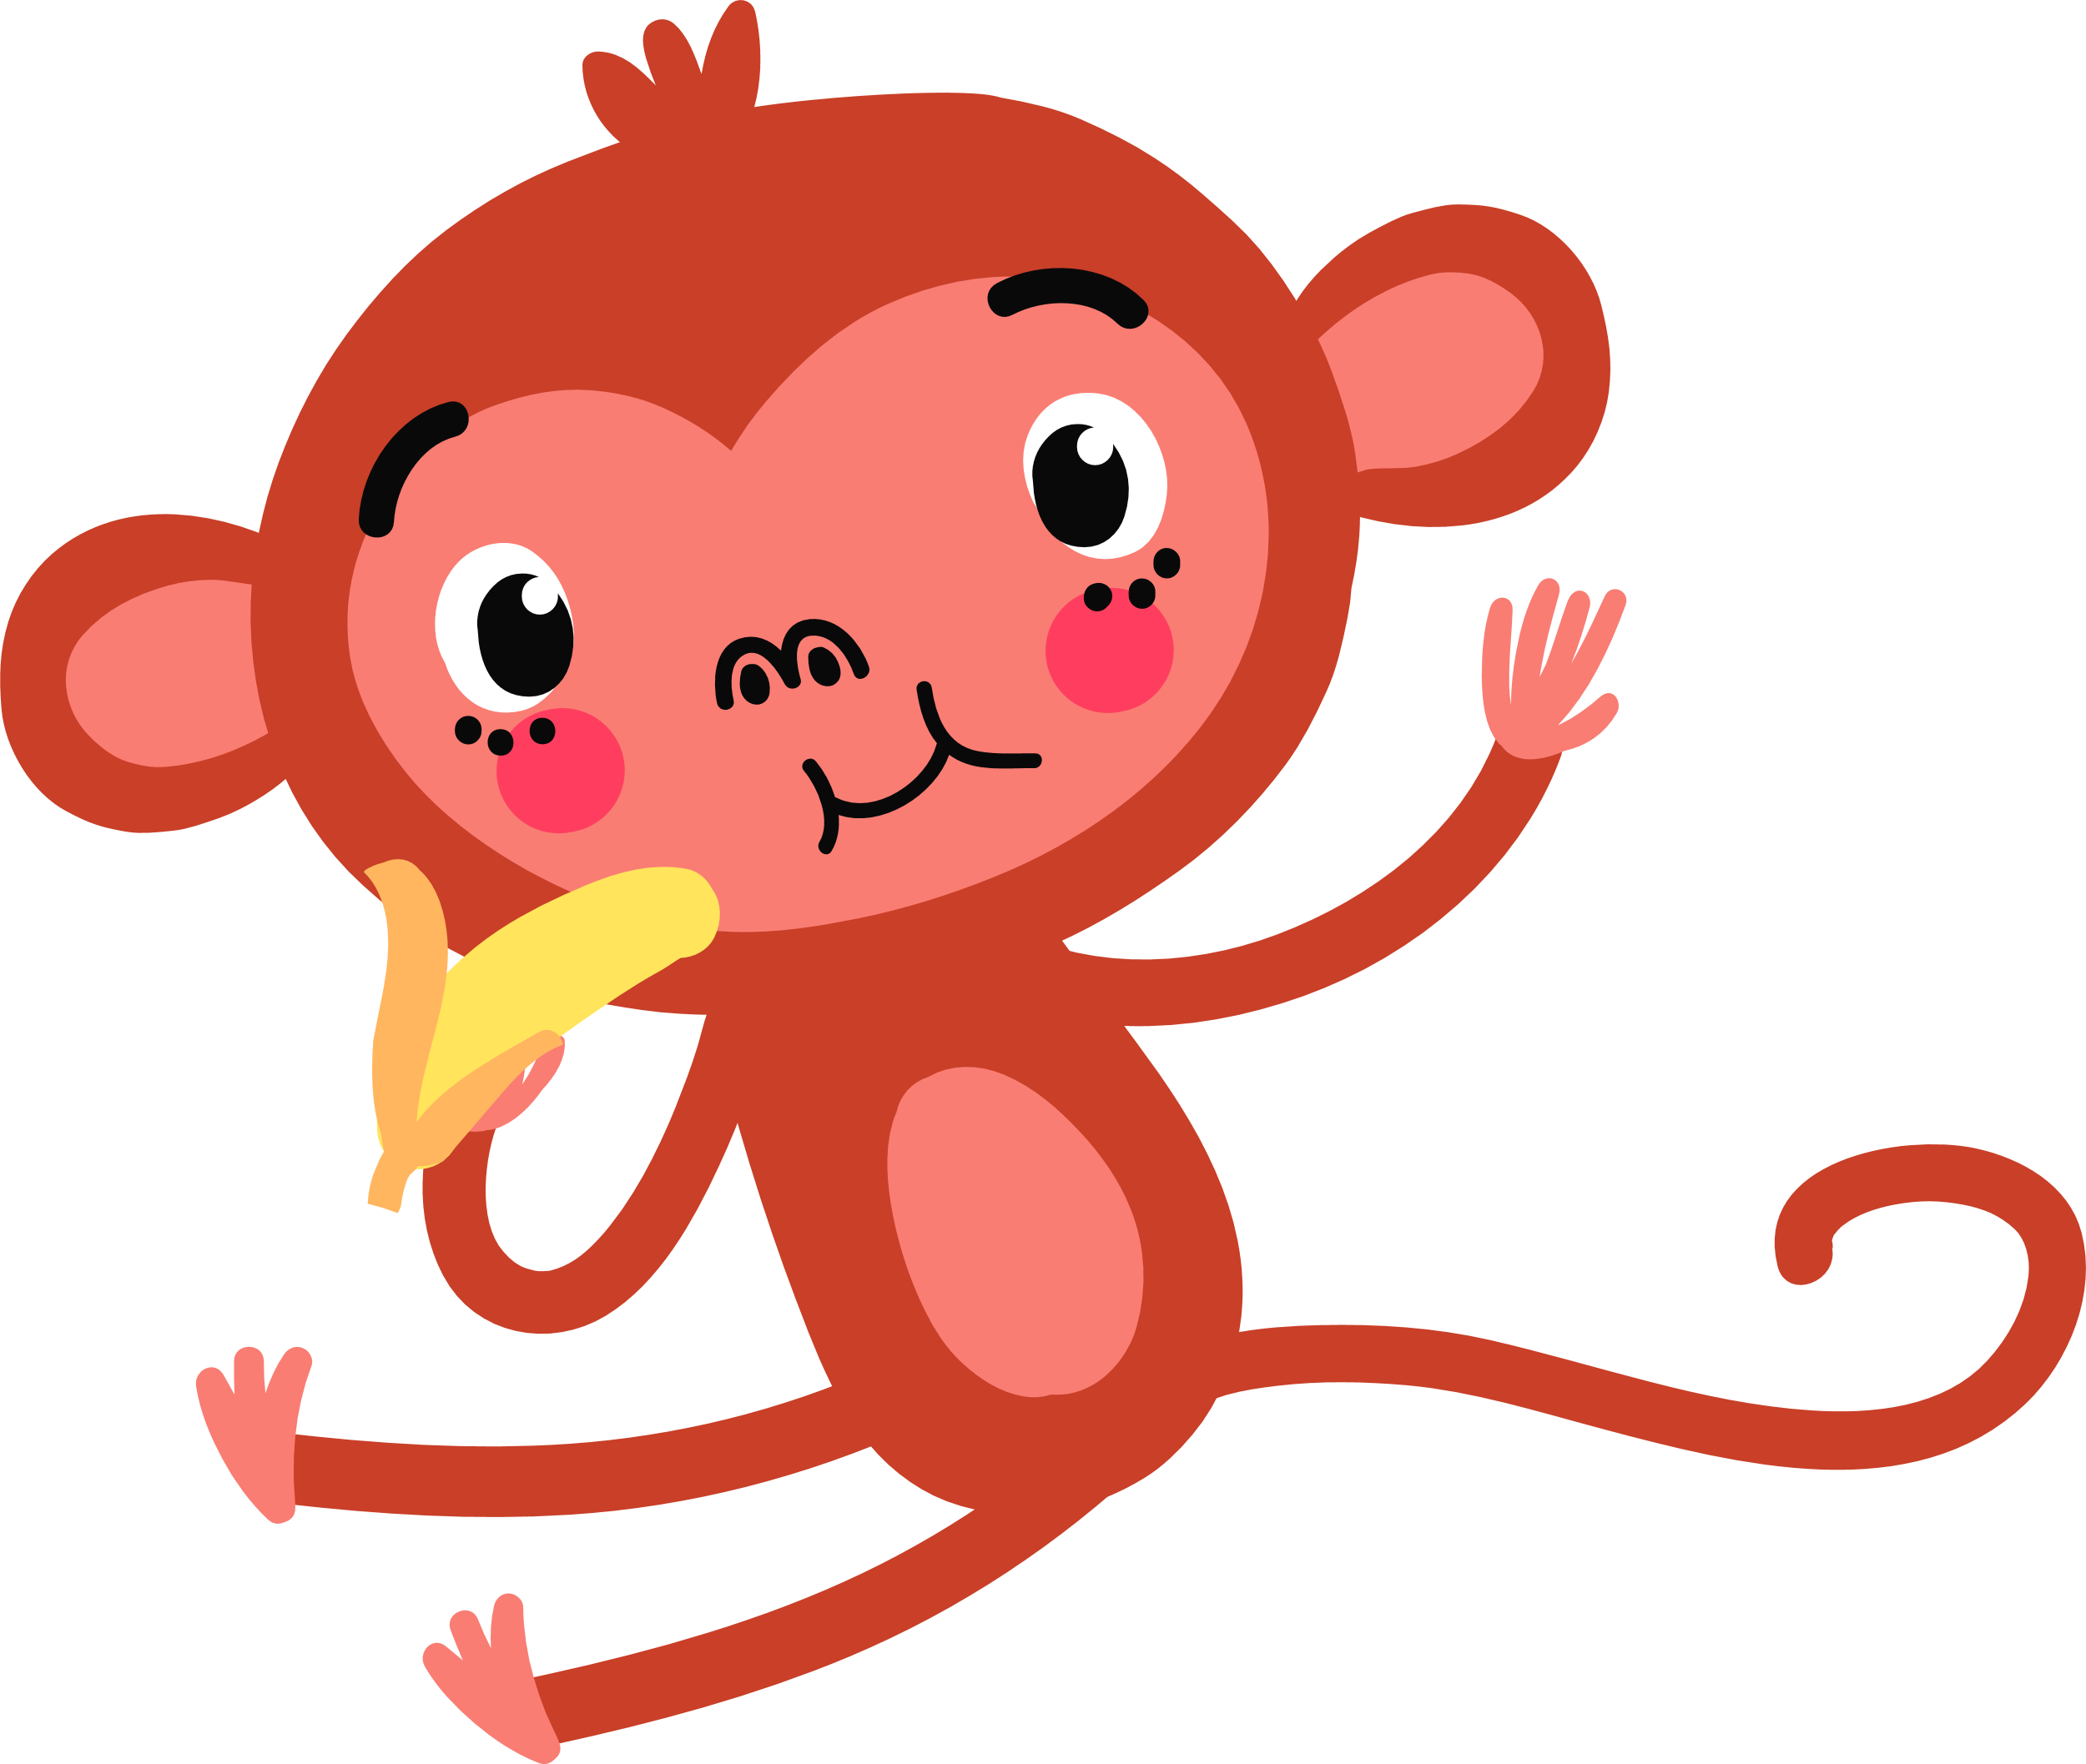
‘I know what can help – it’s called Mindfulness’.
‘Mouthful? Of what?’
It’s hard to know
‘Not mouthful. Mindfulness.’
It can help with a lot of things though I’m not sure if it can help you. We’ll have to see about that.
how to STOP them
‘What can it do? What can it do? Tell me now. Quickly.’
‘Well, perhaps the most important thing for you is that
it can help you to focus and calm down.

Slide 4
However, if we add even more ideas on how to help you feel strong inside and good about yourself then this programme will help you to:
concentrate
think before you act
(and that’s not always easy)
learn better
be in control of yourself
(we call this self-regulation)
feel stronger inside yourself
(we call this resilience)
feel good inside
(we call this self-esteem and self-worth)
and to know how to manage good things as well as difficult ones, like exams and unkind people.

Slide 5
You’re already a superhero Monkey so
now you can be your
best superhero or superheroine.
It’s not hard but you need to work at it. There is no magic but it does feel
as if there is.

Slide 6
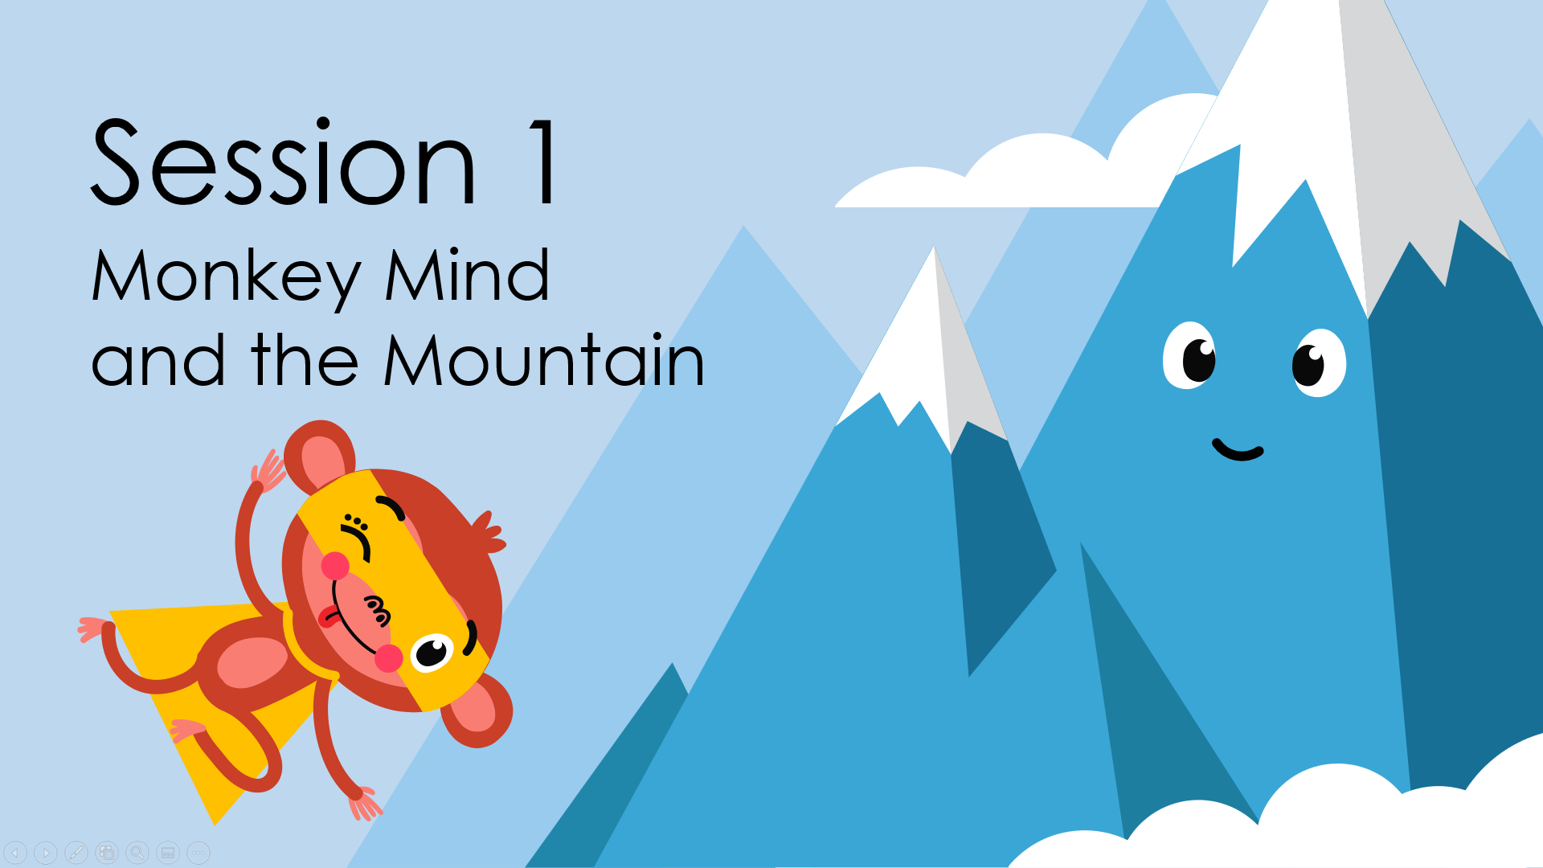
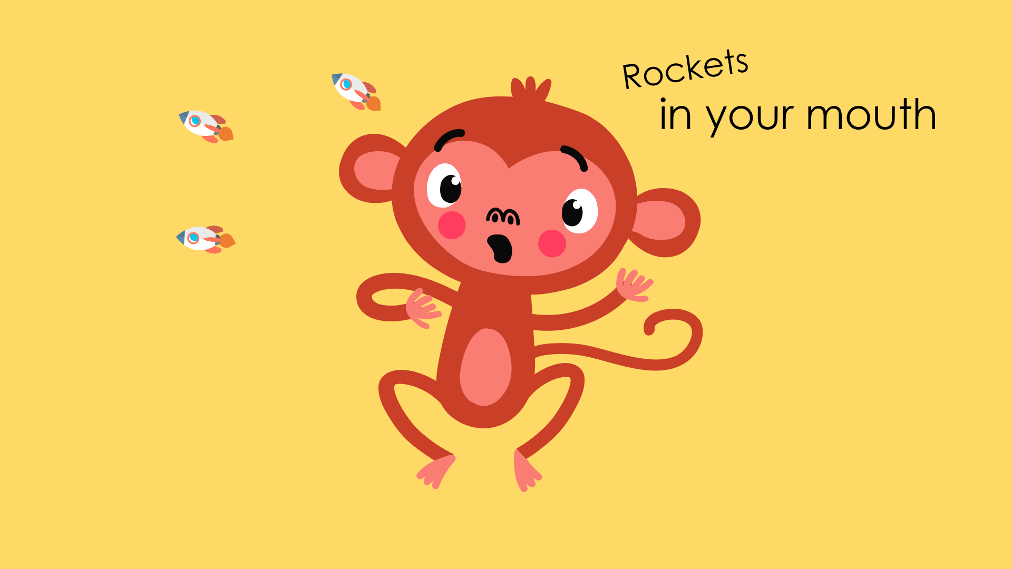
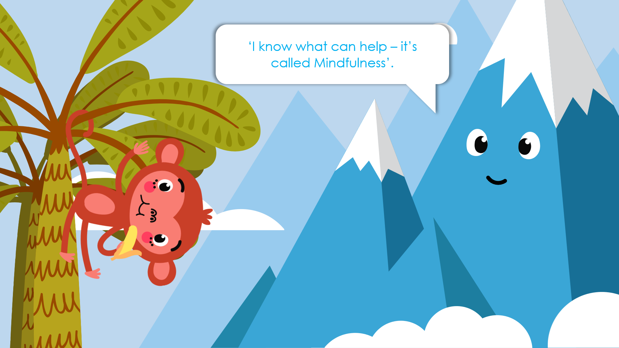
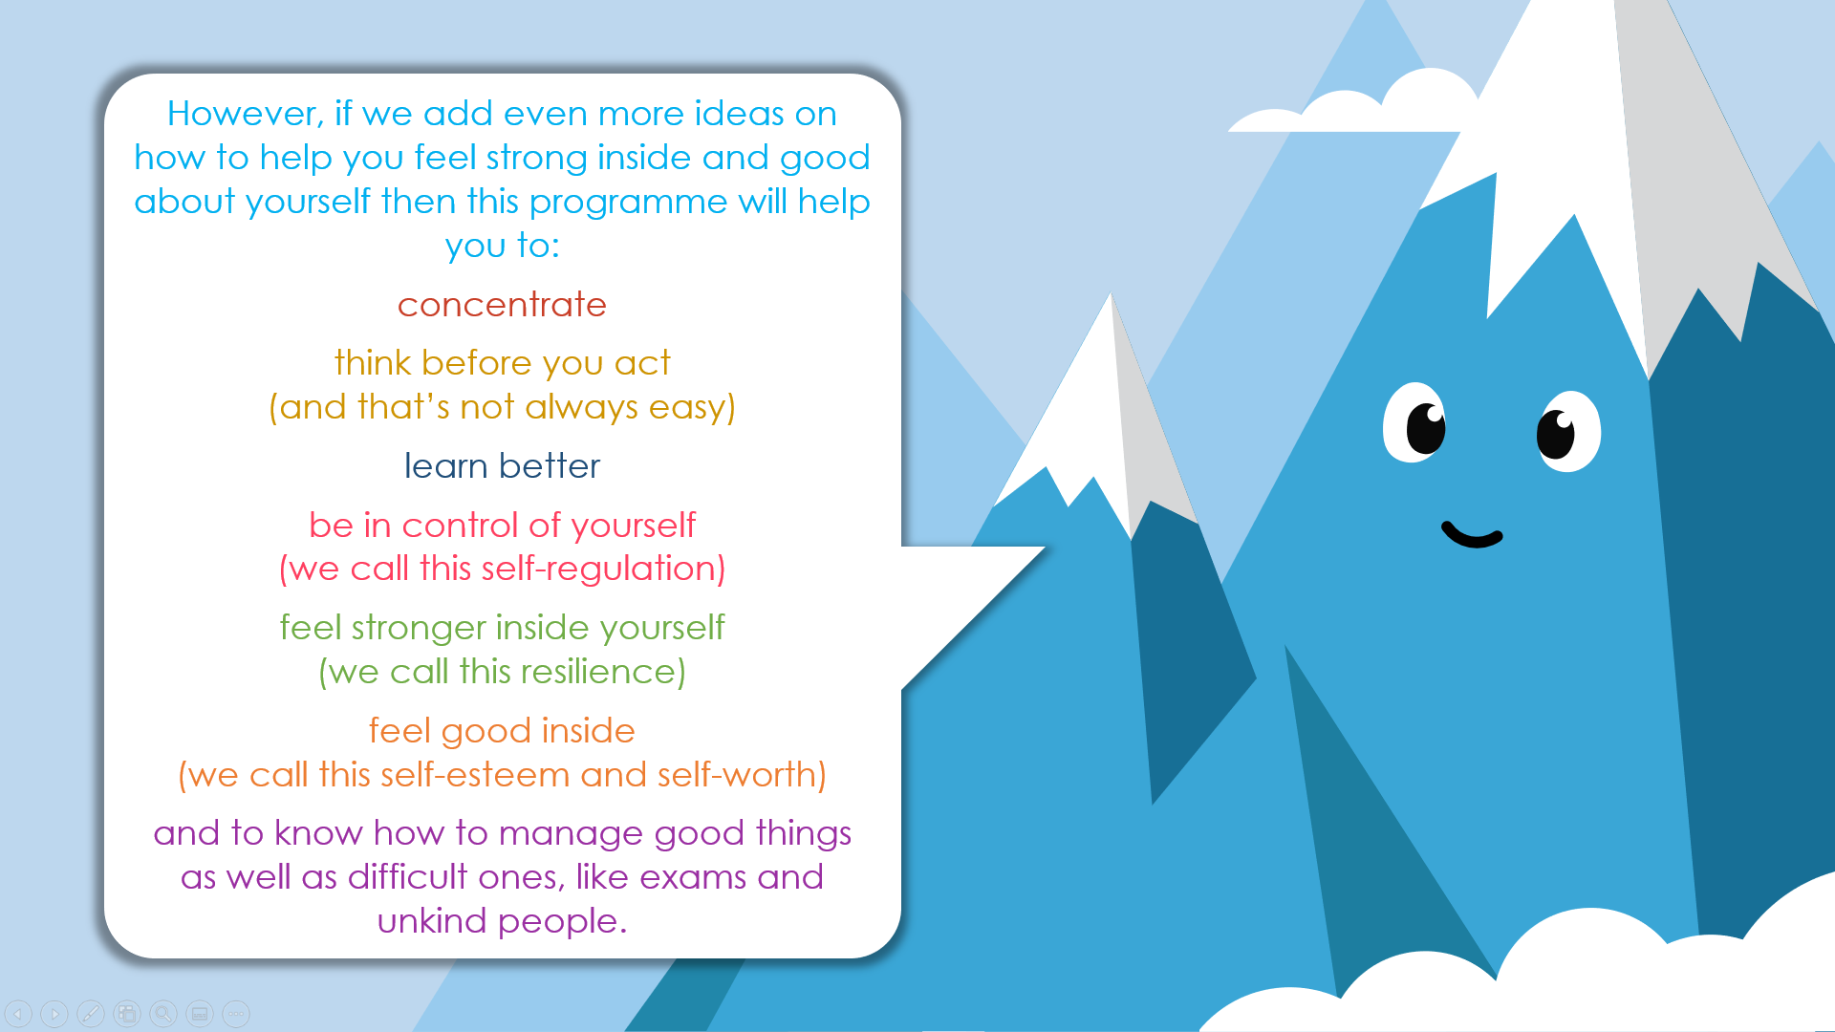
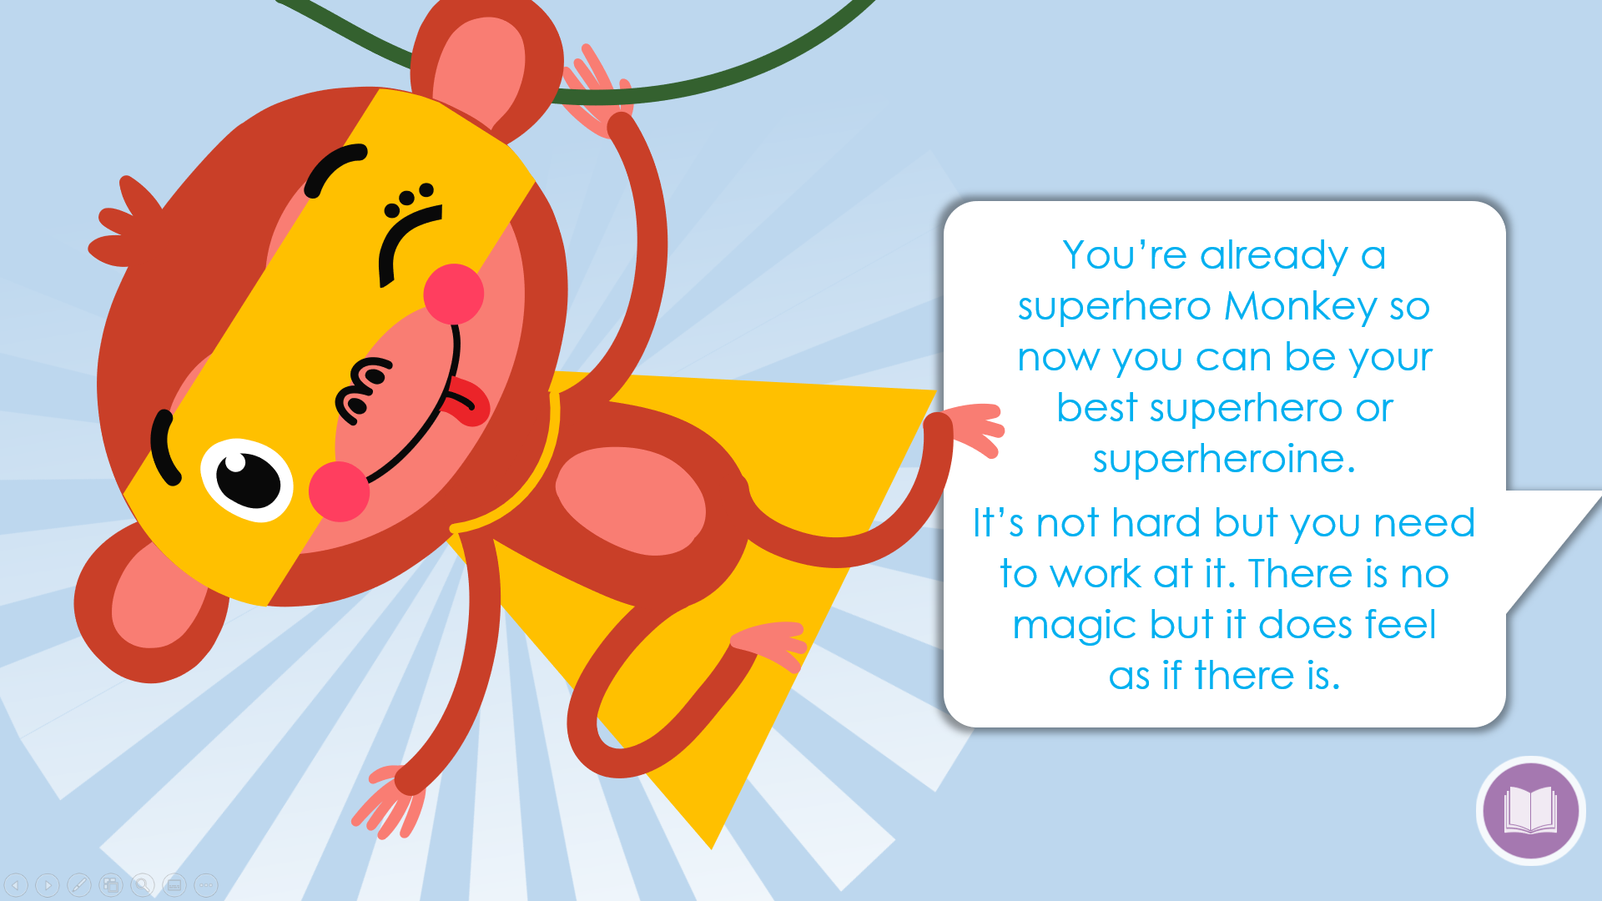
Session 1
Slides: 1 - 5
Let the children jump around like a mad monkey. Tell them to fling their arms, stamp their feet and count to 10.
Now get them to stop like a statue. Count to 10.
Let them jump around again.
Tell them to Stop.
Ask the children what it felt like when they were jumping around and what it was like when they were still.
TASK
Make an eco-friendly glitter jar.
Equipment: Glass jars with lids, biodegradable glitter, water. Glitter is no longer environmentally friendly. It is easy to source eco-friendly glitter and this helps the children to learn about looking for alternatives that don’t have a negative impact.
Let the children shake their glitter jars and then quietly watch the glitter begin to settle.
Tell the children that this is what mindfulness is like for people – we are often running, talking and doing a lot of things but we can also quieten our thoughts and actions and settle down, just like the glitter.

